Slide 1
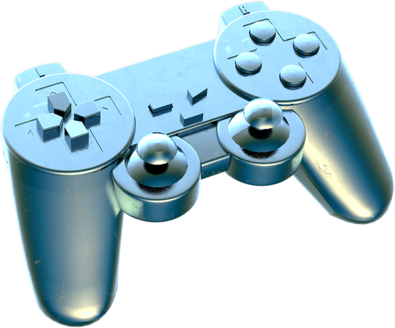

LEARNING MANAGEMENT SYSTEM IMPLEMENTATION TO PROVIDE VIRTUAL SYSTEM FOR STUDENTS AND STAFF OF TUTOR HOUSE INC.
Presented by:
Denice Poblador
John Bernard Cabantog
Gleden De Guia
Renzy Gutierrez
Marcos Reyes

Slide 2

Objectives 1 & 2 : Survey Results
System Evaluation based on Usability
System Evaluation based on Reliability
System Evaluation based on Functionality
System Evaluation based on Efficiency
System Evaluation based on Maintainability
Chapter 4

Slide 3

Objective 1 | Highest Proportion | Median | Interpretation
1. The current manual system effectively informs about my child's academic progress. | 43% | 3 | Moderately Agree
2. Clear visibility into my child's academic situation is a challenge with Tutor House Inc.'s current system. | 55% | 3 | Moderately Agree
3. Tutor House Inc.'s conventional education approach inadequately prepares students for contemporary learning. | 43% | 3 | Moderately Agree
4. Timely feedback on my child's assignments and assessments is lacking in the manual system, complicating the understanding of their academic performance. | 38% | 3 | Moderately Agree
5. I am satisfied with the current manual assessment and feedback from teachers. | 35% | 3 | Moderately Agree
Objective 1 : Survey Results

Slide 4
Objective 2 | Highest Proportion | Median | Interpretation
6. Administrative processes are not conducive enough, leading to extra paperwork and a less organized educational experience. | 50% | 4 | Agree
7. Lack of transparency and clarity in academic performance results from manually recording student progress. | 45% | 4 | Agree
8. Staff and administrators efficiently fulfill responsibilities in supporting students' academic needs through the existing manual system. | 40% | 4 | Agree
9. Implementing advanced technology would positively impact the work efficiency of staff and administrators. | 43% | 4 | Agree
10. The traditional learning management system sufficiently addresses the security and privacy concerns associated with students' academic data and records. | 33% | 4 | Moderately Agree
Objective 2 : Survey Results

Slide 5

Usability | Highest Proportion | Median | Interpretation
The system is easy to utilize and control. | 75% | 4 | Agree
The buttons and other user interactions are working properly. | 85% | 5 | Strongly Agree
The system user interface has a pleasing and satisfying experience for the user. | 75% | 4 | Agree
System Evaluation based on Usability

Slide 6


Reliability | Highest Proportion | Median | Interpretation
The user can rely to the content of the system and the information it gives. | 75% | 4 | Agree
The system itself is reliable under any circumstances. | 70% | 3 | Moderately Agree
System Evaluation based on
Reliability

Slide 7

Usability | Highest Proportion | Median | Interpretation
The system serves its functions based on the specified tasks and objectives. | 75% | 4 | Agree
The overall user experiences(I.e. buttons, grading system) is well attained. | 75% | 4 | Agree
The system serves its purpose. | 100% | 5 | Strongly Agree
System Evaluation based
on Functionality

Slide 8

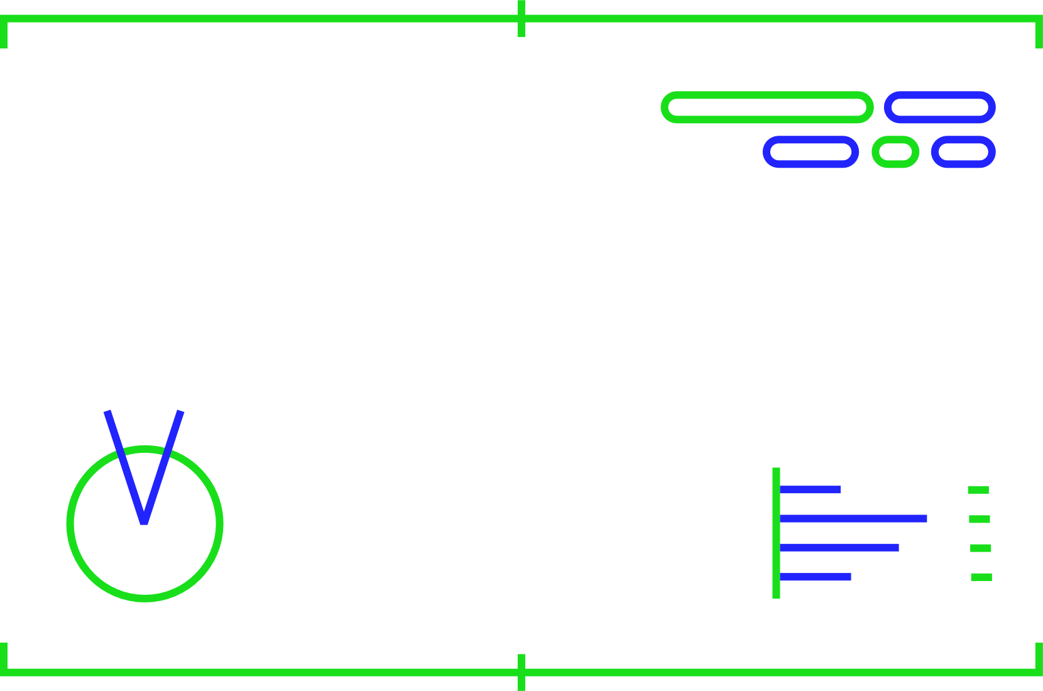
System Evaluation based on Efficiency
Usability | Highest Proportion | Median | Interpretation
The system generates the user requests regularly. | 75% | 4 | Agree
The system displays its features promptly. | 75% | 4 | Agree
The system responses relatively to the time it is functioning. | 70% | 4 | Agree

Slide 9
System Evaluation based on
Maintainability
Usability | Highest Proportion | Median | Interpretation
The system and its features can be modified without introducing defects and bugs. | 60% | 3 | Moderately Agree
The system can be tested and assessed if the criteria has been met. | 85% | 4 | Agree

Slide 10
Chapter 5

Slide 11
The summary outlines the findings regarding the implementation of a Learning Management System (LMS) at Tutor House Inc.. Prior to adopting the LMS, the organization faced challenges such as manual documentation, ineffective communication, and limited access to educational materials. However, the introduction of the LMS transformed their approach, leading to improved administrative efficiency, smoother communication, and a more engaging learning environment for both students and staff. Additionally, the LMS facilitated customized learning experiences to better meet the needs of Tutor House Inc.
Summary
of
Findings

Slide 12
Conclusions
The researchers conclude that implementation of a Learning Management System for Tutor House Inc. can be an effective approach to provide a virtual system for staffs, tutor and students of the institution.

Slide 13
Recommendations
System Configuration and Improvement
Mobile Application Development
Online Backup System

Slide 14
Thank You

